Slide 1
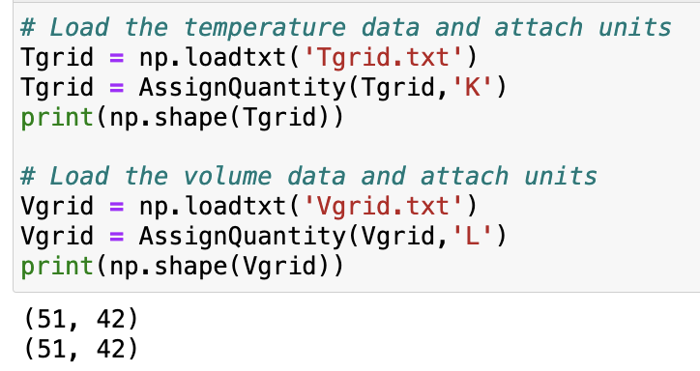

Today we’re going to talk about slices of thermodynamic functions, and their slopes
You may notice that there are some extra files in your folder
These commands load in the state space:
51 temperatures
42 volumes

Slide 2
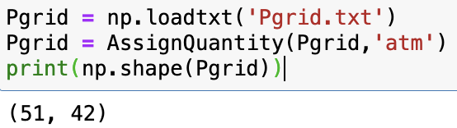
Today we’re going to talk about slices of thermodynamic functions, and their slopes
You may notice that there are some extra files in your folder
This command loads the state function

Slide 3
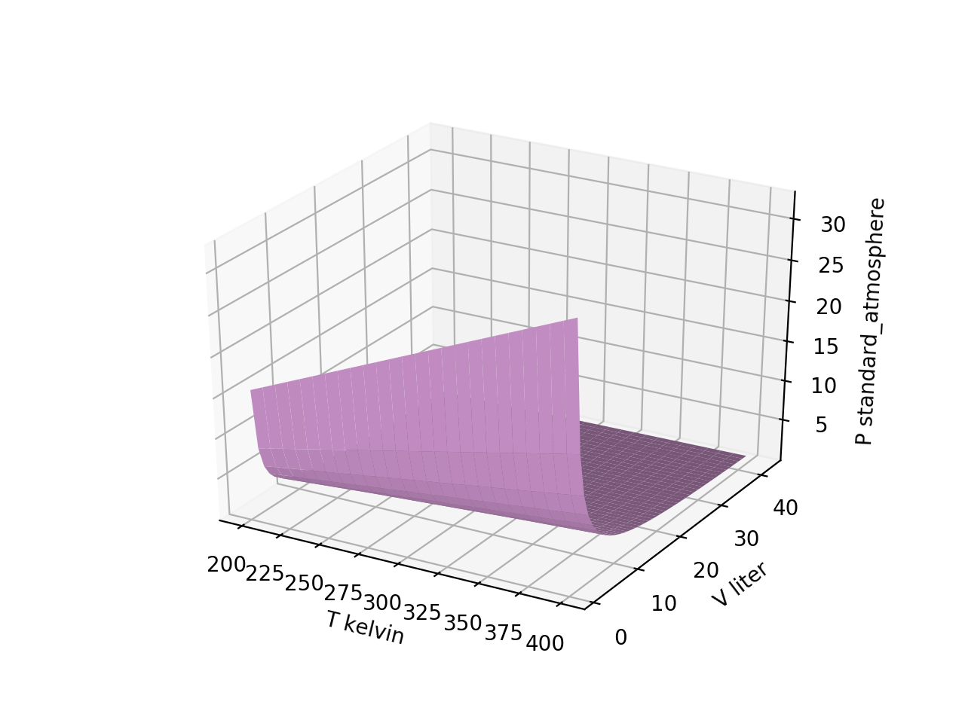
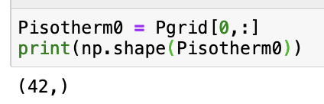
Slicing out the first isotherm of $P(T,V)$

Slide 4

Slicing out the last isotherm of $P(T,V)$

Slide 5
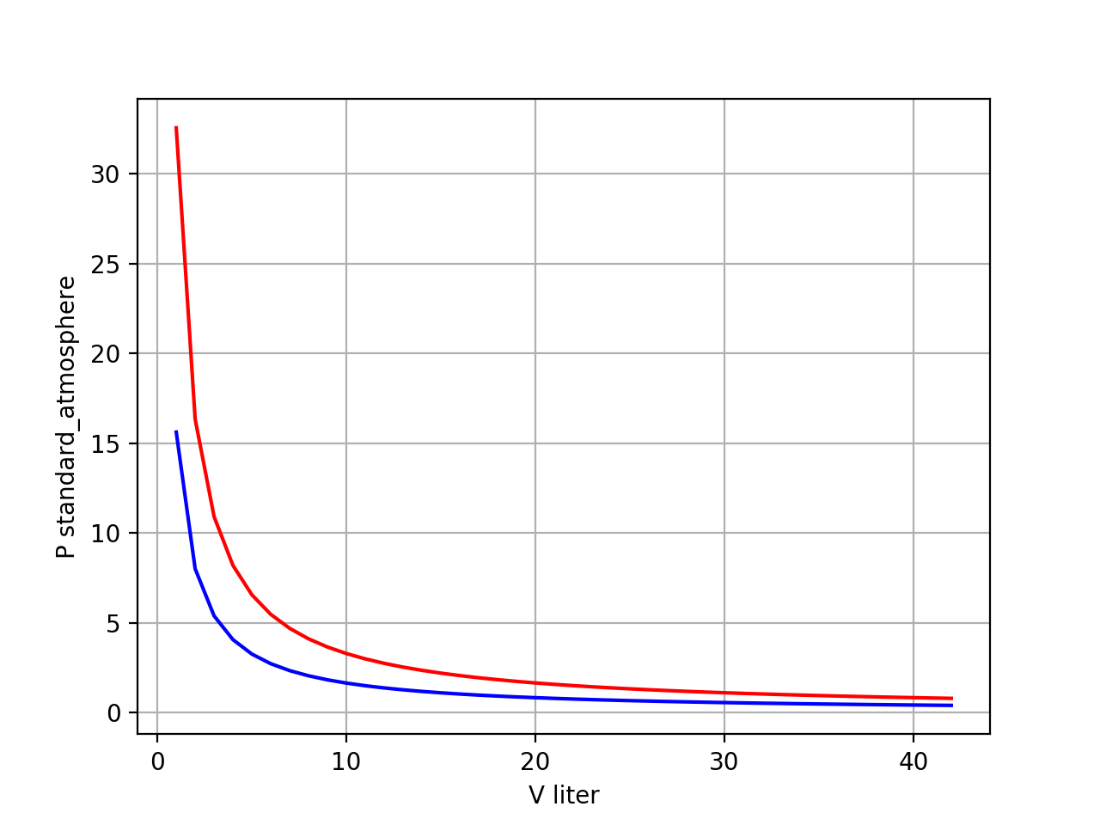
Plotting two isotherms of $P(T,V)$ together
“Boyle Isotherms”

Slide 6
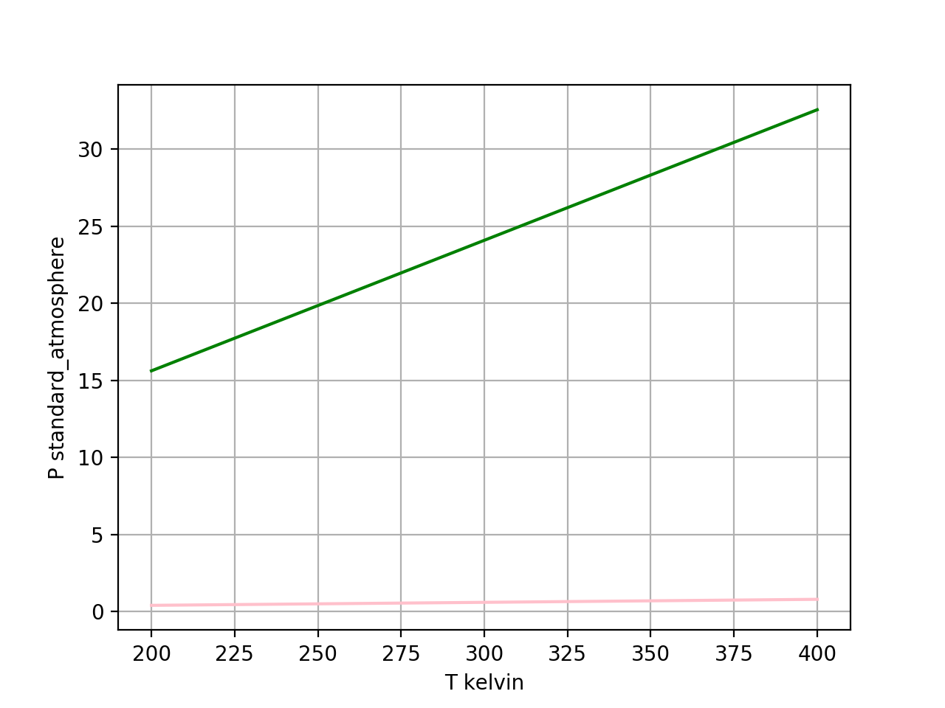
Plotting two isochores of $P(T,V)$ together
isochores

Slide 7
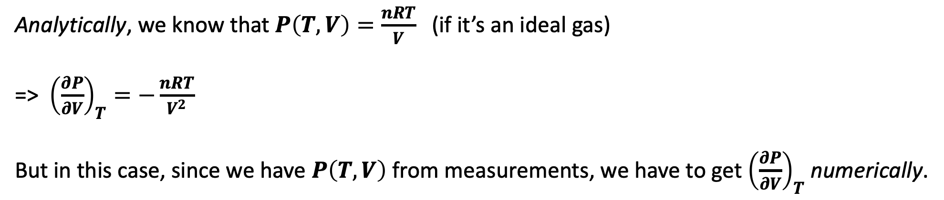
Taking derivatives
Analytically, we know that $P\left(T,V\right)=\frac{nRT}{V}$ (if it’s an ideal gas)
=> ${\left(\frac{∂P}{∂V}\right)}_{T}=−\frac{nRT}{V^{2}}$
But in this case, since we have $P\left(T,V\right)$ from measurements, we have to get ${\left(\frac{∂P}{∂V}\right)}_{T}$ numerically.

Slide 8


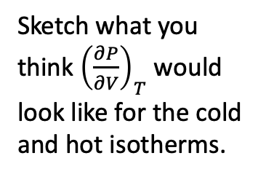
Numerical derivatives of Boyle isotherms
$P(V)$
Sketch what you think ${\left(\frac{∂P}{∂V}\right)}_{T}$ would look like for the cold and hot isotherms.
$${\left(\frac{∂P}{∂V}\right)}_{T}$$

Slide 9
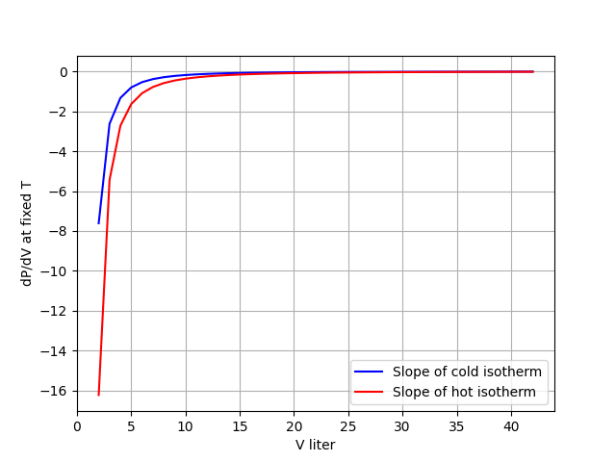
Numerical derivatives of Boyle isotherms
$P(V)$
$${\left(\frac{∂P}{∂V}\right)}_{T}$$

Slide 10
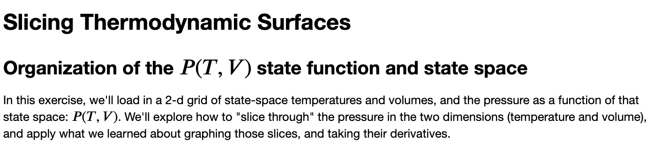
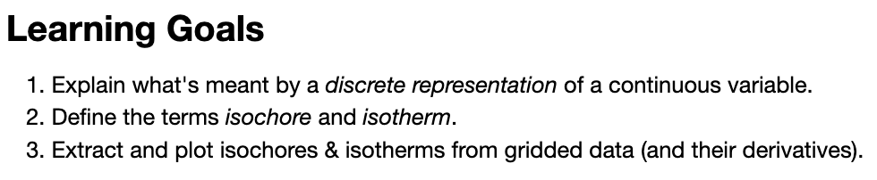
OK, let’s get started

